Slide 1
Azure Training Day Migrating .NET applications to Azure

Slide 2

Presentation title
Let’s get Started!
Tell us what you think by completing our survey
Schedule a post-event session to address your specific requirements.
Speaker name
Title
Learn more : aka.ms/techdocs
Get certified : aka.ms/microsoftlearn
Sign up Developer newsletter: aka.ms/usdevconnect

Slide 3


About Me…
Peter De Tender – MCT, Azure MVP
CEO and Lead Technical Trainer of 007FFFLearning.com, +20 years IT experience, mainly datacenters and Microsoft Infrastructure background
Full-time in Azure since 2013 (Readiness & Architect)
Azure Advisor, Azure Certified Architect
Technical Writer, Book author, Courseware Creator
Living in Belgium, but traveling worldwide 90% of my time, helping larger Microsoft Partners, customers and Microsoft FTEs in learning about and using Azure, by providing workshops with passion
peter@pdtit.be
@pdtit @007FFFLearning
http://www.facebook.com/pdtit
http://www.linkedin.com/in/pdtit

Slide 4
Workshop delivery
For the technical trainers:
Each Module could be presented as a stand-alone module, although the full potential comes from delivering all modules
HOL are somehow depending on each other, starting from the IAC-lab, where students deploy the VM-based source environment, moving to WebApps, SQL PaaS, Docker, Azure Container Registry, running Azure Container Instance, and ultimately Azure Container Services with Kubernetes. (only labs that could be skipped are WebApps and AKS)
The HOL solution is based on a ASP.NET Core app « SimplCommerce » (Open Source), using SQL Database

Slide 5
Workshop delivery
For the technical trainers:
Whenever you detect any mistakes, issues, wrong wordings,… in presentations or LAB guides, please send an email to :
msdevseriessupport@007FFFLearning.com, subject « Azure Developer Series – Containers », so we can take care of this and fixing it immediately
Latest version of all content should be available on GitHub:
http://www.github.com/007FFFLearning/MSDevSeriesSupport

Slide 6
Introduction to Containers

Slide 7
The journey to the cloud
From Virtual Machines to Software as a Service
SaaS apps
Serverless
Replace
Microservices
From on-premises systems to cloud applications
Containers
Rebuild or New
VMs
Rearchitect
Existing on-premises infrastructure and applications
Refactor
Rehost
App Modernization
Digital Transformation – started years ago already

Slide 8
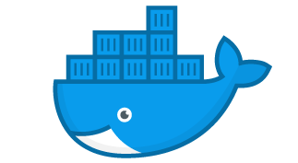
What are containers?
Virtual machines
Containers
Container
Container
Container
Container
App
App
App
App
App
App
App
Binaries & Libraries
Binaries & Libraries
Binaries & Libraries
Container
Container
Container
Container
Guest VM Operating System
Guest VM Operating System
Guest VM Operating System
App
App
App
App
Binaries & Libraries
Binaries & Libraries
Hypervisor
Docker Engine
Host Operating System
Host Operating System
Physical Server
Physical Server
Virtualize the hardware
VMs as units of scaling
Hypervisor dependent
Not easily movable
Virtualize the operating system
Applications as units of scaling
Platform independent
Easily movable across environments (on-premises, multi-cloud)

Slide 9
How do containers help in app modernization?
Containers are stand-alone, smaller application instances, running at scale
Container
Container
App
App
App
Binaries & Libraries
Container
Container
Guest VM Operating System
App
App
Existing/New Applications (=rehome)
Lift and shift to containers (= rehost, refactor)

Slide 10

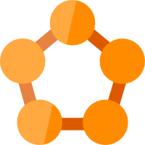





Running Containers on Azure: a full set of choices
App Service
Service Fabric
Kubernetes Service
Container Instance
Partner Ecosystem
Deploy web apps or APIs using containers in a PaaS environment
Modernize .NET applications to microservices using Windows Server containers
Elastically burst from your Azure Kubernetes Service (AKS) cluster
Bring your Partner solutions that run great on Azure
Scale and orchestrate Linux containers using Kubernetes
Azure Container Registry
Docker Hub
Choice of developer tools and clients

Slide 11
How Containers help in App Migration
Enterprises can’t get away from their legacy apps just like that:
Expensive
Risk involved
Developers are gone
Complexity
Enterprises benefit from Containers:
Legacy apps are supported
Containers are future-proof
Cost optimized
Secure

Slide 12

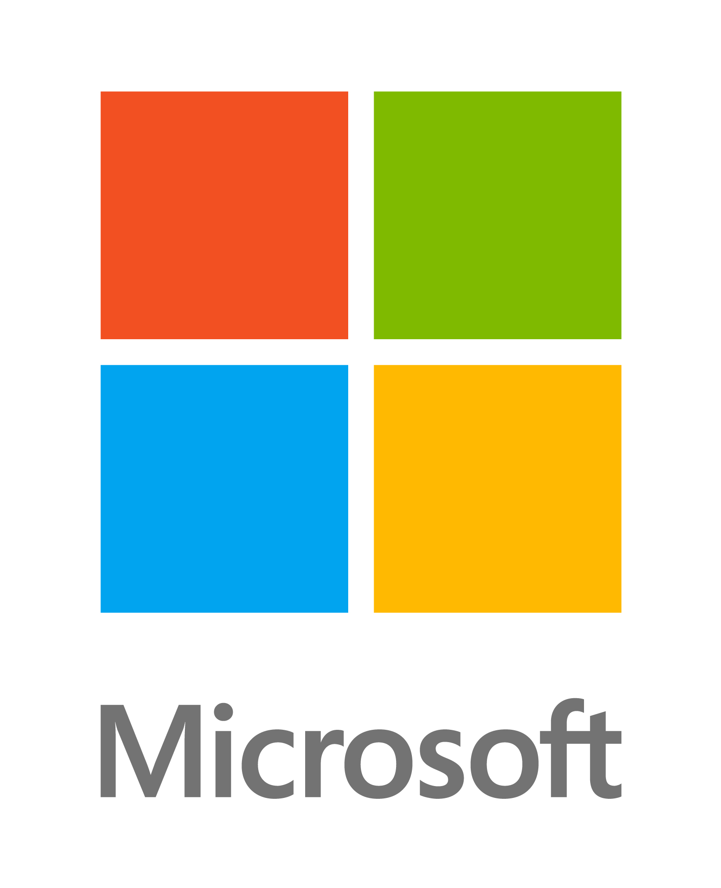


How Containers help in App Migration
On-Premises
Co-location
Run Anywhere
Public Cloud XYZ
Azure
Container Image
Windows or Linux

Slide 13
Docker Containers Overview

Slide 14

Docker Containers - Overview
What is Docker?
Leading Open-Source Containerization Platform
Natively Supported in Azure
Cross-Platform (Win, Linux,…)
Docker containers wrap up a piece of software in a complete filesystem that contains everything it needs to run: code, runtime, system tools, system libraries – anything you can install on a server. This guarantees that it will always run the same, regardless of the environment it is running in
Source: www.docker.com

Slide 15










Docker High-Level Architecture
Docker Concepts
1
Client
2
Host
3
Registry
Docker build
Docker pull
Docker Run
Docker …
Docker Daemon / Docker Service
Docker Hub
Azure Container Registry Cloud XYZ Container Registry
Containers
Images

Slide 16
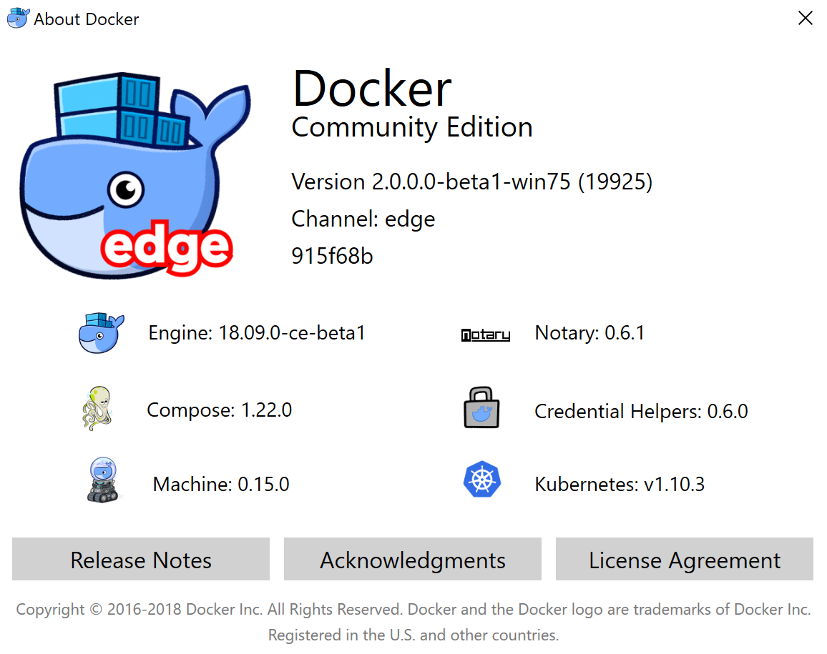
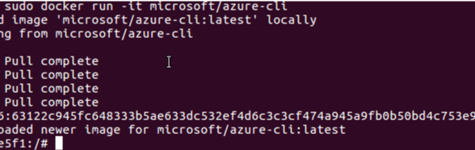
Docker Host
Windows-based (Win10/Win2016-2019)
Linux-based

Slide 17
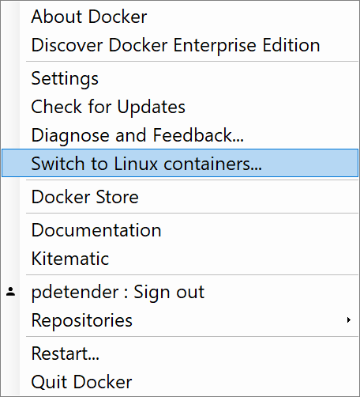
Docker Containers on Windows
Runs on Windows 10 client or Windows Server 2016/2019
Supports both Windows and Linux Containers, and you can easily switch
Requires Hyper-V or « Containers » Feature
CLI integration with PowerShell or command prompt
Docker CE = Free !!

Slide 18
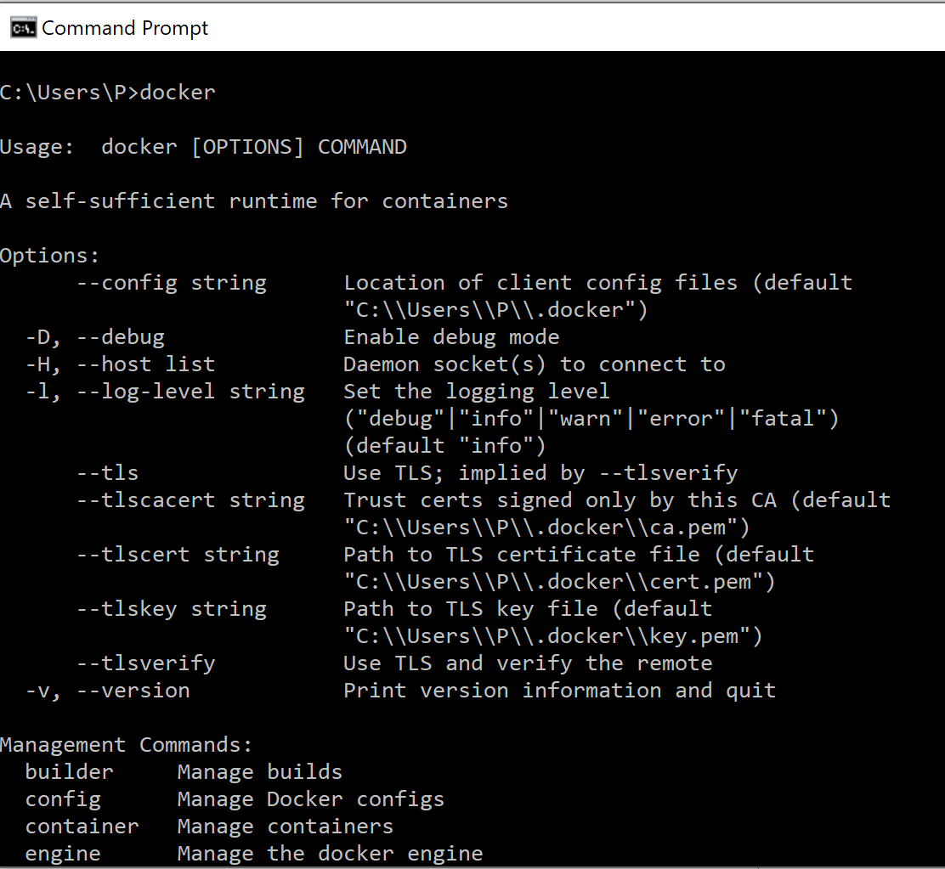
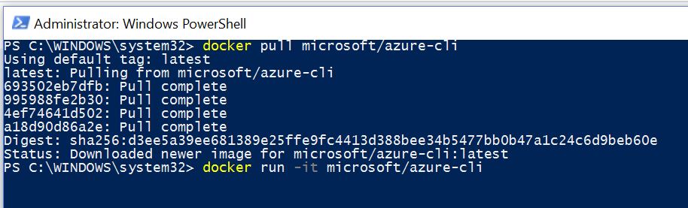
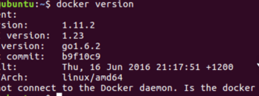
Docker CLI
Command Line Interface

Slide 19
Demo
Running Docker for Windows

Slide 20
Docker Host
Where do you run your Docker Container Images?
On top of a « host » Operating System, like:
Windows 10
Windows Server 2016/2019
Linux
Mac OS
On top of a « Docker » cloud platform:
Azure Container Instance
Azure Container Services
Azure Virtual Machines

Slide 21
Where do Docker Images come from?
Docker Hub
Hub.docker.com
Free resource of PUBLIC images
Option to create PRIVATE images
Cloud Container Registry
Library of Docker Images
Azure Container Registry
Mainly used for storing PRIVATE images
Docker Hub
Azure Container Registry

Slide 22
Running a Docker Container
docker run -i -t ubuntu /bin/bash
Docker CLI command
Run container with interactive terminal
Pull "ubuntu" image from Docker Hub or local registry
Command to execute inside the container

Slide 23
Common Docker CLI operations
docker run - Use an image to run a container
docker pull - Pull an image from a registry
docker build - Build a Docker image
docker images - List available Docker images
docker ps - List running Docker containers
docker exec - Execute a command in a container
docker stop - Stop a running container

Slide 24
Demo
Common Docker CLI Operations

Slide 25
Migrating apps to Docker Images

Slide 26
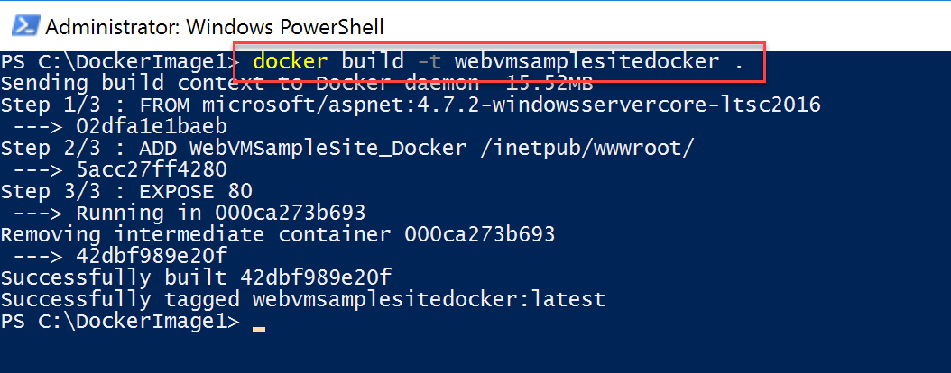
Building a Docker Image - CLI
1
docker build - Build a Docker image
2
docker images - List available Docker images

Slide 27
Building a Docker Image - DockerFile
A Dockerfile is a text document that contains all the commands a user could call on the command line to assemble an image. Using docker build, users can create an automated build that executes several command-line instructions in succession.
FROM microsoft/aspnet:4.7.2-windowsservercore-ltsc2016
ADD WebVMSampleSite_Docker /inetpub/wwwroot/
EXPOSE 80

Slide 28
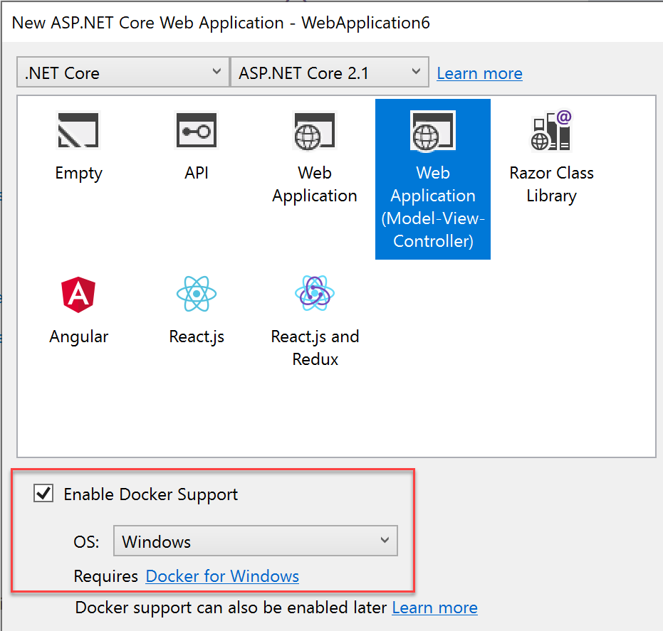
Building a Docker Image – VS2017-2019
When using Visual Studio 2017-2019, together with Docker for Windows on the same client, you get Docker integration features
https://docs.microsoft.com/en-us/aspnet/core/host-and-deploy/docker/visual-studio-tools-for-docker?view=aspnetcore-2.1

Slide 29
Demo
Building a Docker Image (CLI and VS2019)

Slide 30
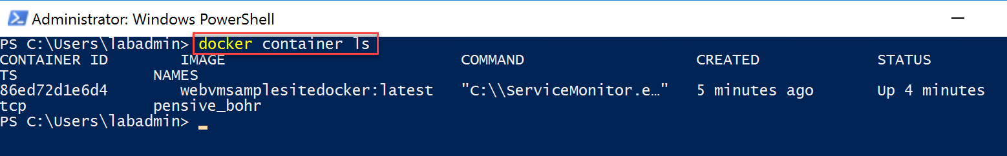
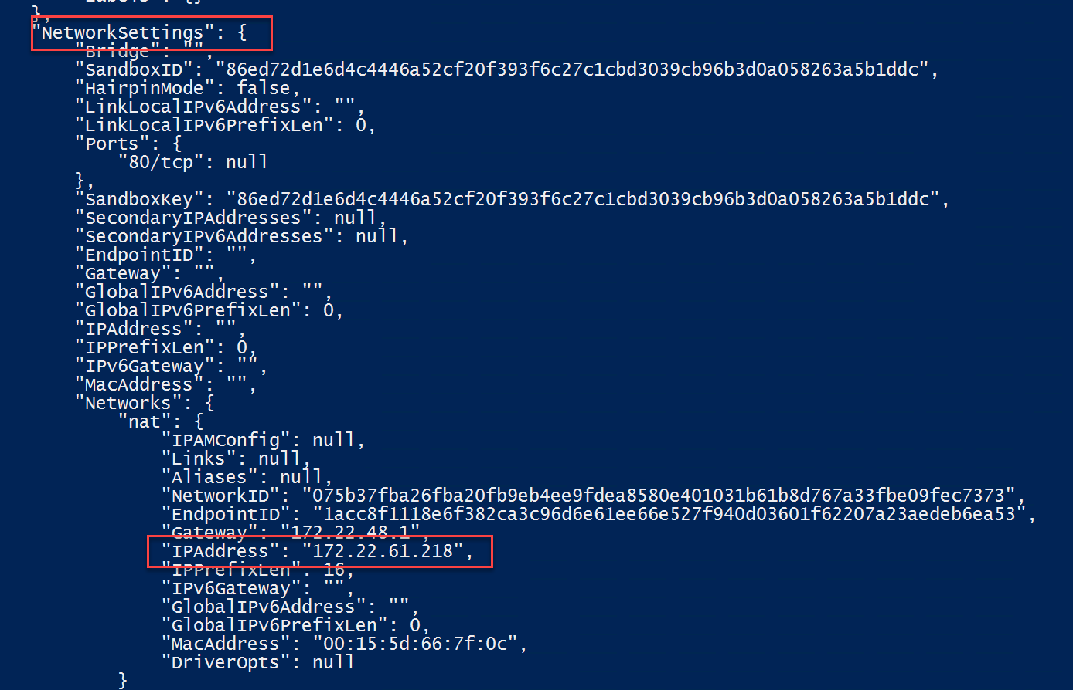
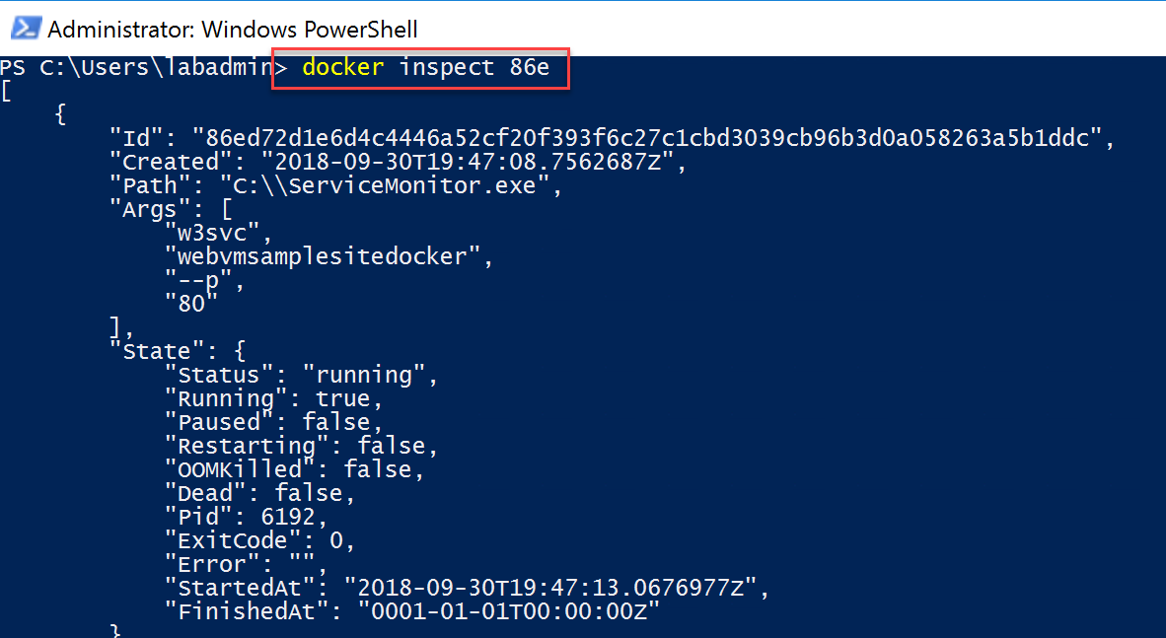
Troubleshooting Docker Containers
1
docker container ls – Lists all containers on a host
2
docker inspect – Shows all information of a container

Slide 31
Azure Container Registry

Slide 32
Azure Container Registry (ACR)
Pull images from ACR and use it in different deployment targets:
Azure Kubernetes Services (AKS)
DC/OS MesoSphere
Docker Swarm
Azure compute solutions
Azure WebApp for Containers
Azure Container Instance (ACI)
3 different SKU’s:
Basic
Standard
Premium
Azure Container Registry is a managed Docker registry service based on the open-source Docker Registry 2.0. Create and maintain Azure container registries to store and manage your private Docker container images.

Slide 33
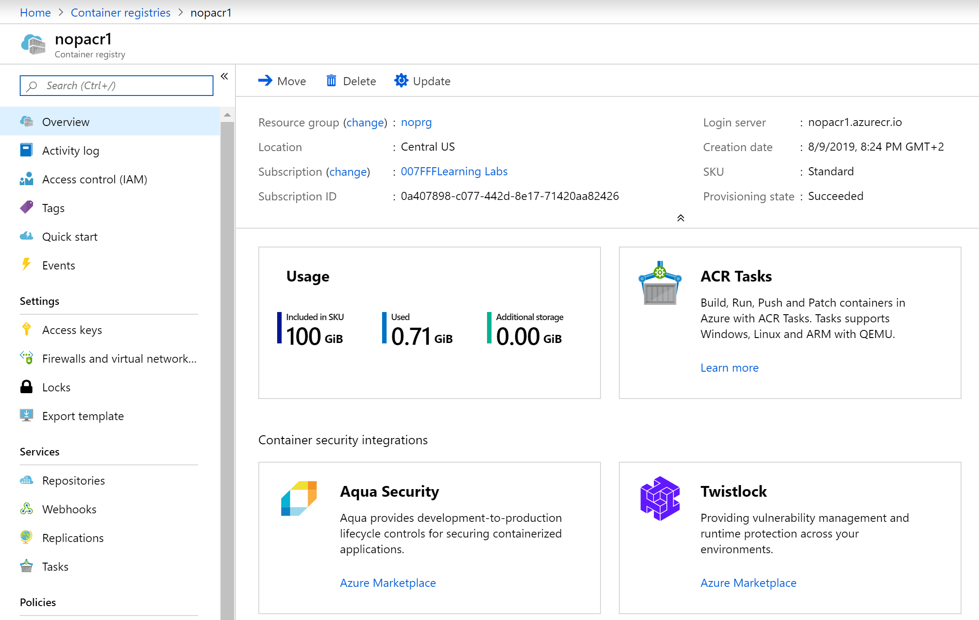
Azure Container Registry (ACR)
Similar to the public Docker Hub, but running within an Azure Subscription, offering Private images

Slide 34

Azure Container Registry (ACR)
Automating OS and Framework Patching
Registry
Registryname.azurecr.io namespace
Image
Read-only snapshop of a Docker Container
Repository
Groups of Container Images
Container
Software application in a bundled file system

Slide 35
Azure Container Registry (ACR)
3 different SKUs to choose from
Basic | Standard | Premium
Cost optimized entry-point for developers | Sufficient for most production workloads | For the enterprise-use of containerized apps
Same capabilities than Standard and Premium, but limitations on size and usage | Increased storage limits and image througput | Higher offerings on storage, concurrent operations and high-volume scenarios
 |  | Geo-Replication for managing a single registry across multiple regions

Slide 36
Azure Container Registry Tasks
Cloud-based container building, including OS updates and patching
Quick Tasks – container lifecycle management
Trigger container image build when updates happen to Git Repo
Automate OS and Framework patching (base image)
Automatically rebuild application images (app image)
Multi-Step Tasks (preview)

Slide 37
Demo
Deploying an Azure Container Registry

Slide 38
Azure Container Instance

Slide 39
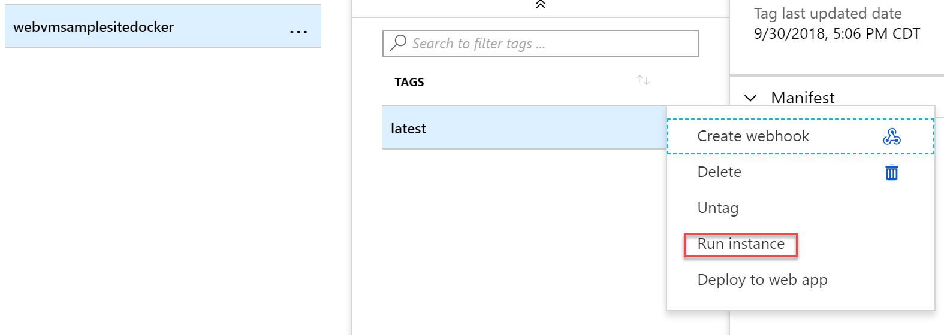
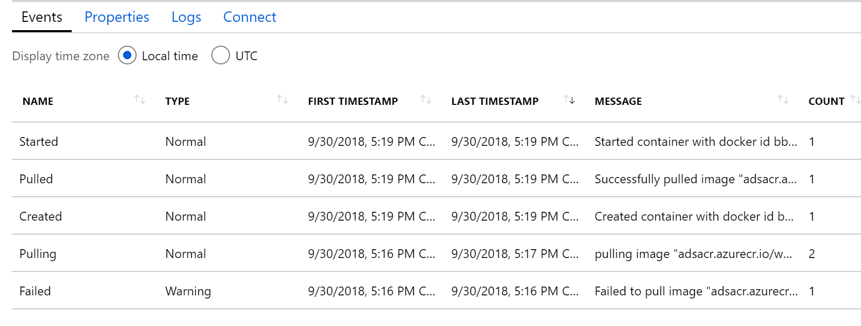
Azure Container Instance (ACI)
Run Containers directly from Azure Container Registry:
Detailed Event Logging
No additional Orchestration needed
Integrates with Azure monitoring and diagnostics capabilities
Azure Container Instances offers the fastest and simplest way to run a container in Azure, without having to provision any virtual machines and without having to adopt a higher-level service.

Slide 40
Demo
Running an Azure Container Instance

Slide 41
Webapp for Containers
Running Containers as WebApps

Slide 42
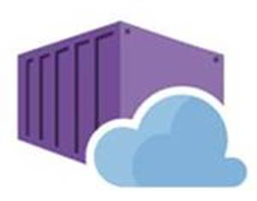
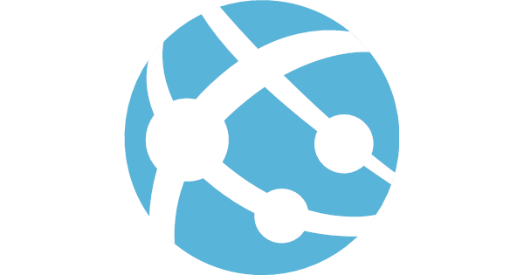




Web App now supports running Containers
Bring your code
Bring your container
.NET Core
Web App for Containers
Deploy to Azure in seconds
Scale easily on demand
Designed for your agile web development needs

Slide 43
Containers as Web Apps - Benefit
Why running Containers as Azure Web Apps
Treat the container as a web app
All common Azure Web App features are valid for Containers as well:
Backup
Monitoring
App Insights
App Service Plan (Although the plans are different for containers!)

Slide 44
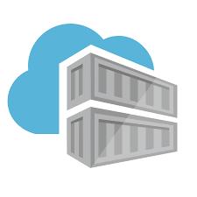



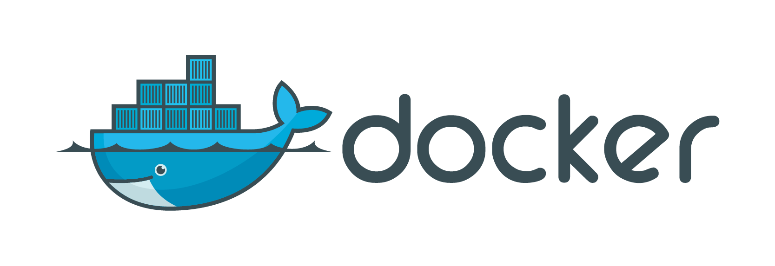
Azure App Service: Build and Deploy Options Deploying containers
Private container registry
Azure Pipelines
Docker push
Pulls container image
Azure Container Registry
Runnable web app
in Azure App Service
Docker build:
Docker Hub build
Docker build on dev machine
Etc…
Docker Hub

Slide 45

Web app for containers
High productivity development
Fully managed platform
Enterprise-grade apps
Deployment
with ease
CI/CD build
and deploy
Built-in auto scale and load balancing
High availability with auto-patching
Global data center footprint
Private registry
support
Testing in production
Staged deployment
with slots
Monitoring
and diagnosis
Backup and recovery
AAD integrated
Secure + compliant

Slide 46
Windows Container Support Public Preview
Windows Server 2019 Host Support
Smaller containers, higher density of apps, faster pull and start times
Server Core Containers reduced by over 60% from WS2016LTSC
Take advantage of improvements not available on WS2016
Key Scenarios
Lift and Shift to PaaS
Applications which have dependencies
Applications blocked by traditional App Service Sandbox
Data center migration
Capabilities
Available in six regions globally
PowerShell and CLI Support
Bring Your Own Storage – Azure Files
Application layers
Customization layers
Base OS—layer

Slide 47
Demo
Deploying Azure WebApps for Containers

Slide 48
Section Take-Aways
Docker is the standard for containerized applications
Containers allow for digital transformation, by supporting your (legacy) applications to modern platforms, both on-premises and in the cloud
Azure fully supports running containers using Azure Container Registry, Azure Container Instance, WebApp for Containers and Azure Kubernetes Services

Slide 49
Questions
Landing
Spot
“…If you want good answers, ask better questions…”
© Randy Glasbergen

Slide 50
Next Module…
Deploying and Running Azure Kubernetes Services
@pdtit @007FFFlearning

Slide 51
Thank You

